Slide 1

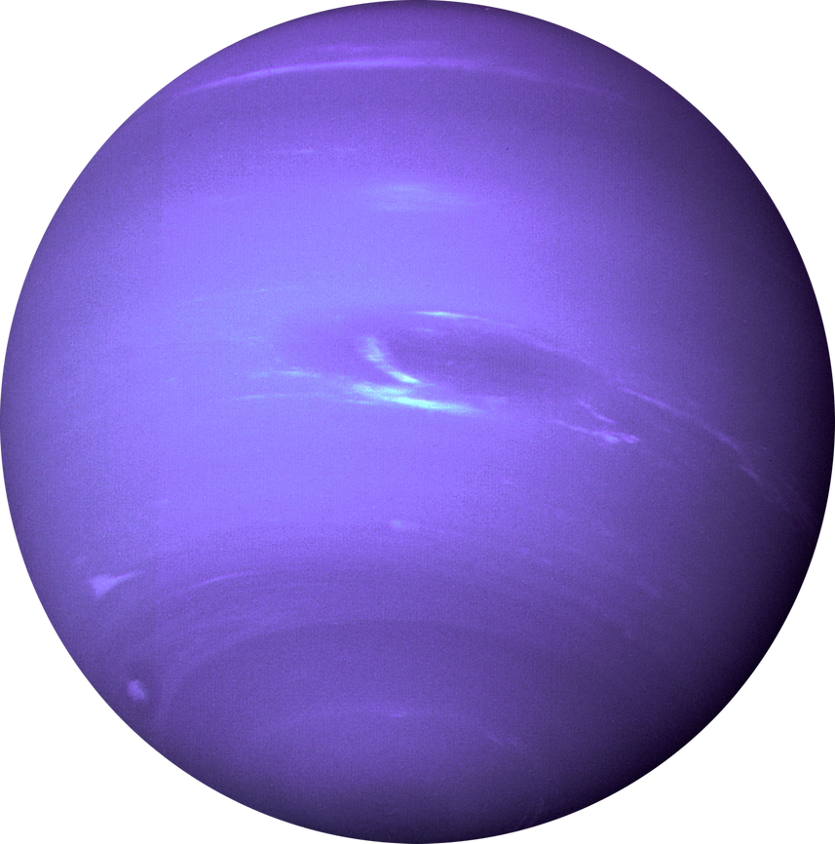


IN COLLABORATION WITH THE AZ NAU/NASA SPACE GRANT
THE SCIENCE OF STORYTELLING: SCIENCE WRITING WITH THE AZ DAILY SUN
Madison Easton
Mentor Chris Etling
2023-2024 COHORT

Slide 2
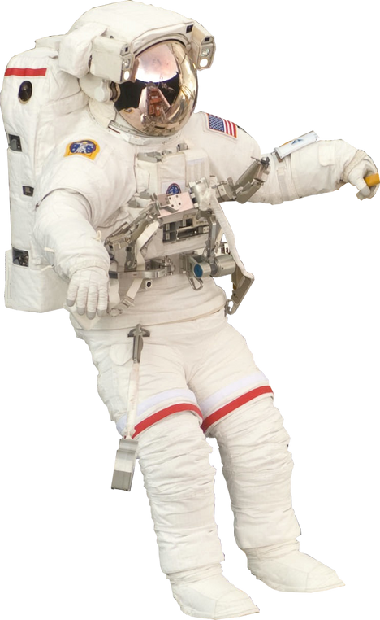
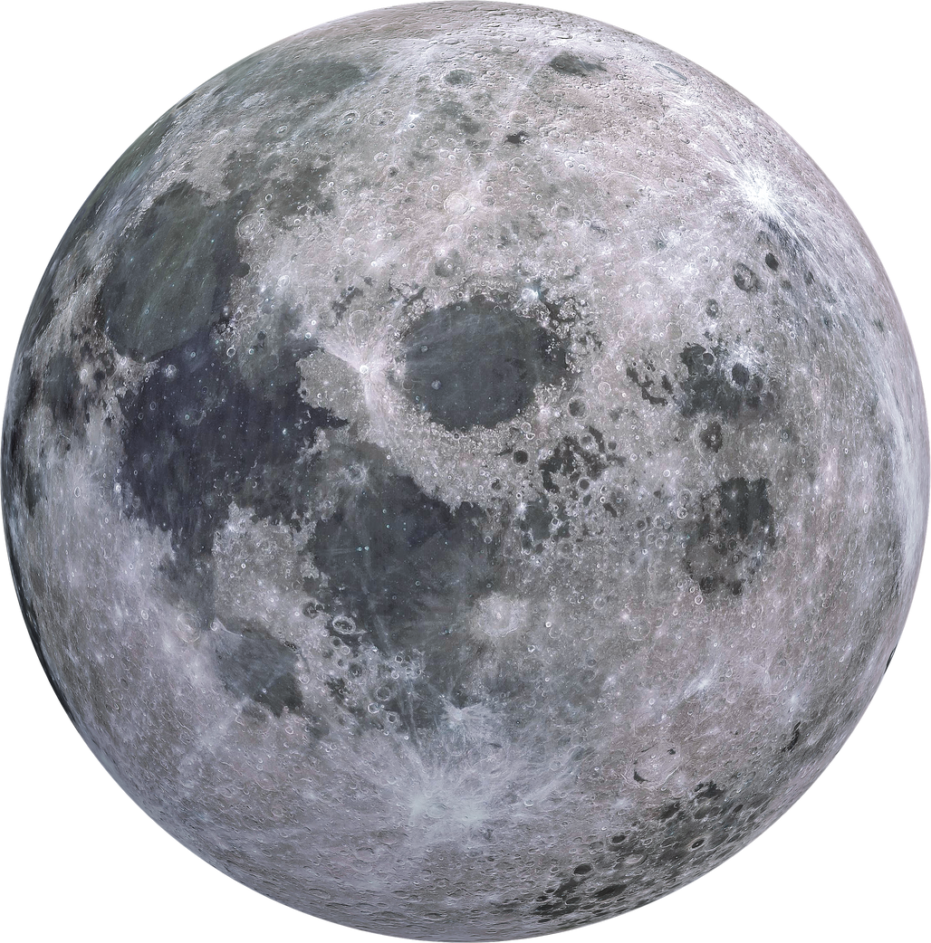
OBJECTIVES
Practice a wide range of science journalism including event coverage, feature pieces, and research briefs
Engage with the science community within Flagstaff and practice networking and interview techniques with people of a range of backgrounds
Act as a translator for complex scientific information into the common tongue for reader interest and engagement
Practice Photojournalism and Documentary photography

Slide 3
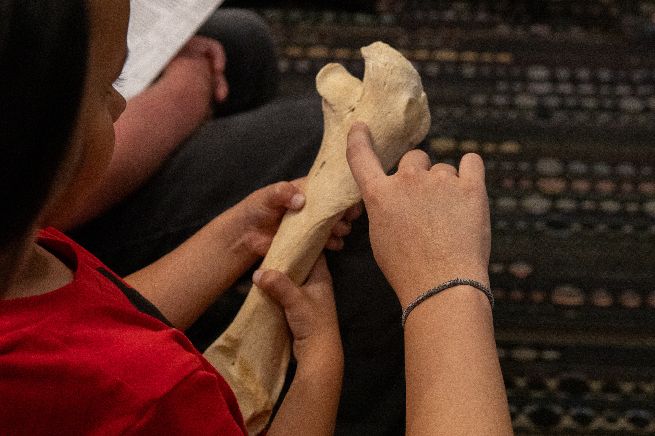
PUBLICATIONS: EVENT COVERAGE
Article #1: The Annual Flagstaff Festival of Science Brings Together Children of All Ages to Explore Hands-On Learning
Angle: The Flag Festival of Science is an annual event that brings the community together with STEM and a theme around a keynote speaker. I wanted to talk about STEM education and the childhood development aspect of the festival
Interviewees: Dr. Alice Christie, Library Specialist Shea McCall, Dr. Chrissina Burke, Guests Olivia Sharest and her son Louis
Take Aways: It is funny trying to interview children. Many people in the community including parents and their children love the Flag Festival of Science

Slide 4
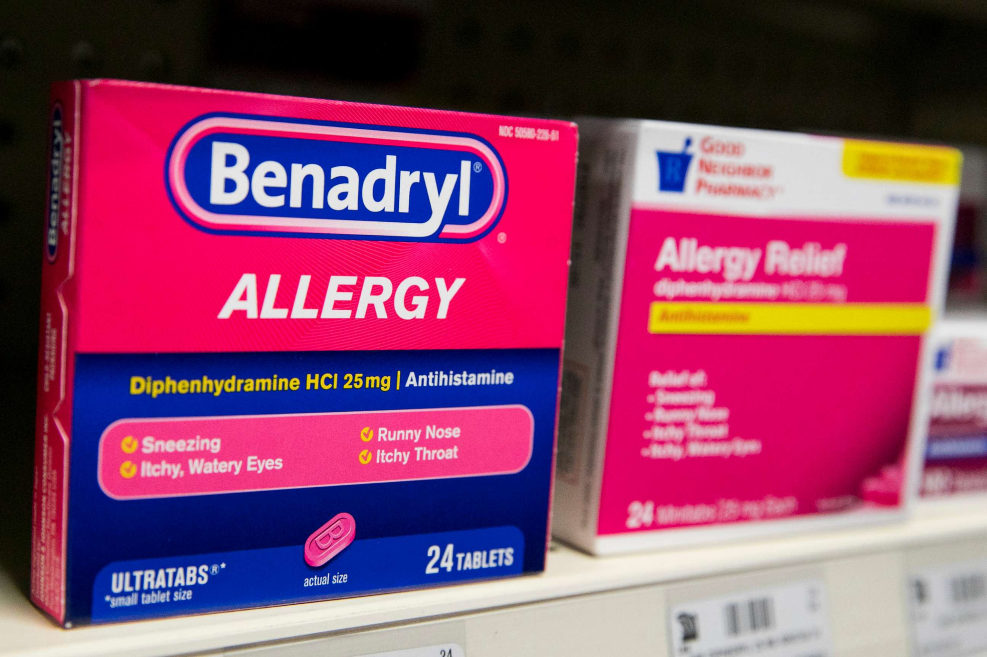
PUBLICATIONS: RESEARCH BRIEF
Article #4: Benadryl, Tylenol PM and other anticholinergic drugs may increase chances of developing Alzheimer’s disease and other forms of dementia
Angle: Research brief led by the interview with a neurology Doctor
Interviewees: Cognitive and Behavioral Neurologist Dr. Jeremy Pruzin
Take Aways: It is hard to get in contact and interview scientists and doctors. Don’t be afraid to let the interview and someone more versed on the subject direct you to something bigger!

Slide 5
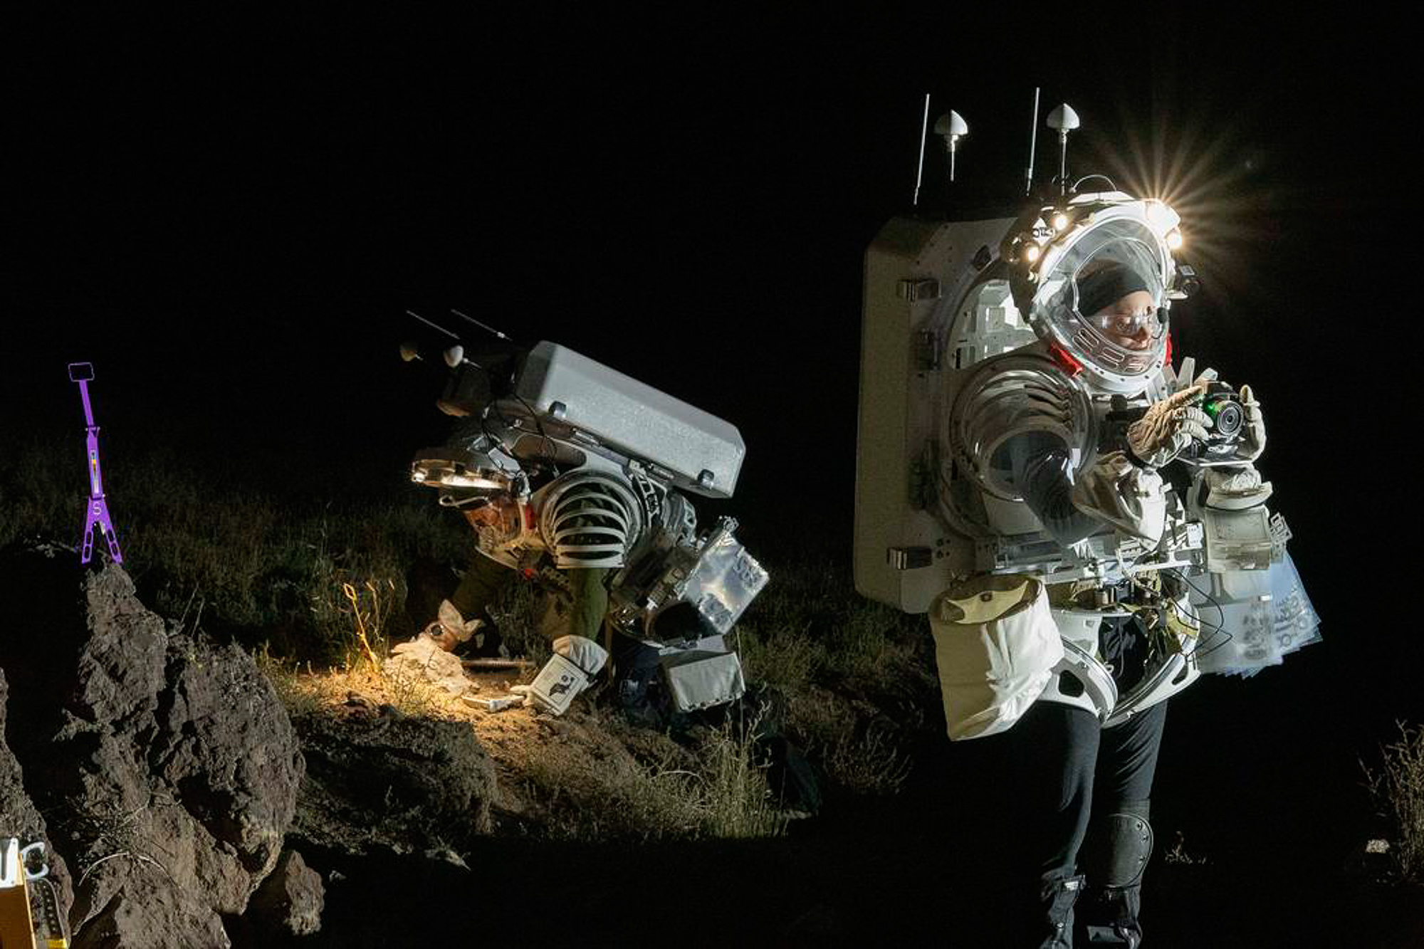
PUBLICATIONS: FEATURES PIECE
Article #5: The USGS Astrogeology Center sends astronauts to the moon from Flagstaff, Arizona, with love
Angle: A look into the local USGS Astrogeology Center and the importance of Northern Arizona as a training ground for NASA astronauts
Interviewees: USGS Research Scientist Greg Vaughan, Supervisory Geologist Jim Skinner, Deputy Principal Investigator for the Artemis III geology team Lauren Edger
Take Aways: There is so much awesome local stuff to report on, just dig deeper! Don’t be afraid to ask for questions or clarification on topics you know nothing about (your readers might be in the same boat)

Slide 6
Importance of Science Writing
Journalists and other science communicators act as translators of valuable information into the minds of non-scientists who deserve to know. While science and curiosity are innate, we are often discouraged by accessibility and lack of interest, but science journalism can reignite that interest and make discovery and inspiration accessible.

Slide 7

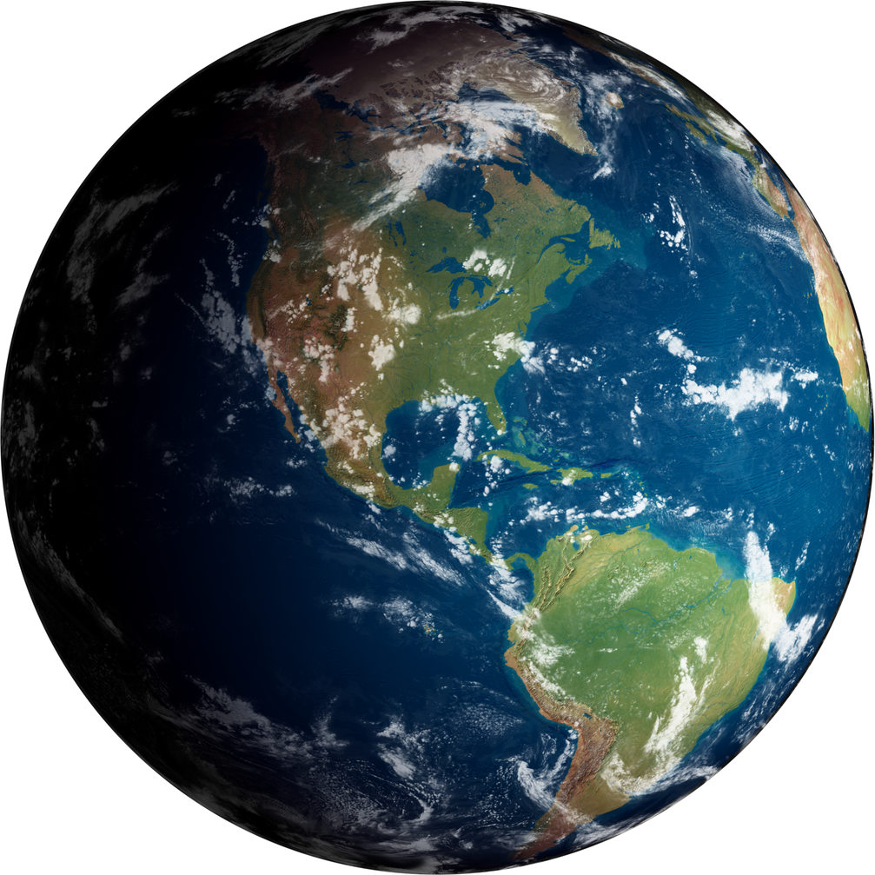
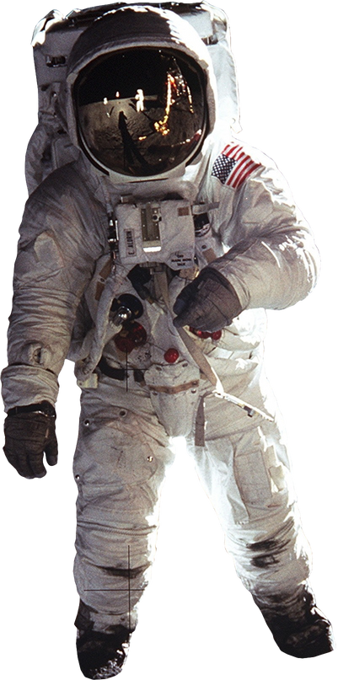
THANK YOU
Scientific Project

